Slide 1

Astral Beast Entertainment
Alex Slowik : Producer/Tech Director
Jordan Hardwick: Physics Programmer
Tony Smith: Graphics Programmer
Nick Studley: Game Designer

Slide 2
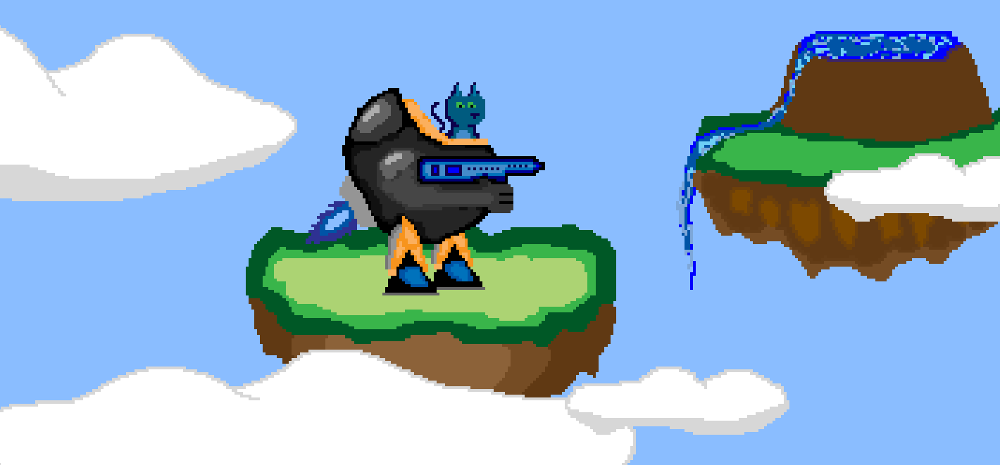
Spacecat Nim
High concept: 2D action platformer in which the player pilots a combat mech

Slide 3
Game Concept 1
Player uses various movement mechanics
(jumping, hovering, boosting)
Obstacles create interesting challenges
(moving platforms, environmental conditions)

Slide 4
Game Concept 2
Movement abilities (jumping, hovering, boosting)
Different abilities and weapons for combat
(blaster, missiles, laser sword)
Enemies drop power-ups

Slide 5
Game Concept 3
Movement, combat, and upgrades
Enemies drop minerals, which can be used to purchase upgrades and additional weapons
(increased hover duration, rapid fire)

Slide 6
CoreEngine Object
Contains entire application
Everything happens in CORE->GameLoop()
The Frame function handles events that occur every frame
Core
GameLoop
Frame

Slide 7
Engine Systems
Systems attached to the core engine
Core
Graphics
Physics
Object Factory
Others
Each system has Initialize, Update, Shutdown
Example: Factory->Update calls Update on all objects,
each object then calls Update on all of its components

Slide 8
Object Factory
Objects are component based and data driven
Serializer reads archetypes from text files
This info is used to create archetype objects
Archetype objects are copied to create game object instances
Archetype
Text
File
Archetype
Object
Game Object
Instance

Slide 9
Tools
Visual studio 2010 + visual assist X
Premake4
Mercurial with TortoiseHG workbench
Photoshop
Trello
Tiled map editor
STL containers

Slide 10
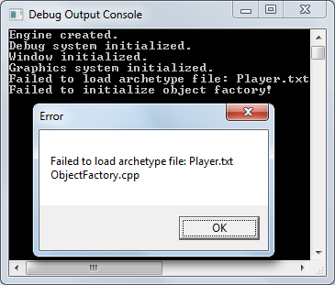
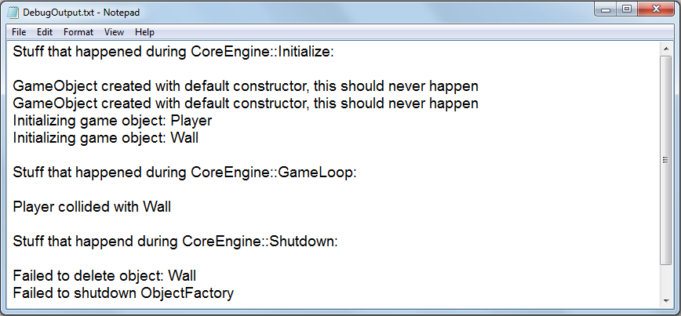
Debugging
Debug ouput console
Bool result = initialize();
if(!result) { return false; }
“Exploding Comments”
Debug output text file

Slide 11
Physics : What We Have
AABB Collision
-Separating Axis Theorem
Force-based movement
-Using velocity and acceleration

Slide 12
Physics: What We Need
Jumping and gravity
Hovering
Friction
Bouncing objects

Slide 13
Graphics: What We Have
DirectX 10
Using built-in D3DX sprite class
World matrix for scaling, rotation, translation
Z-order and u-v mapping
DrawSpritesBuffered function
for batching draw calls
Animations working, but not integrated

Slide 14
Graphics: What We Need
Multi-part sprites
Parallaxing background
Scaling and Rotation (if needed)
Camera following the player
Probably will not use shaders

Slide 15
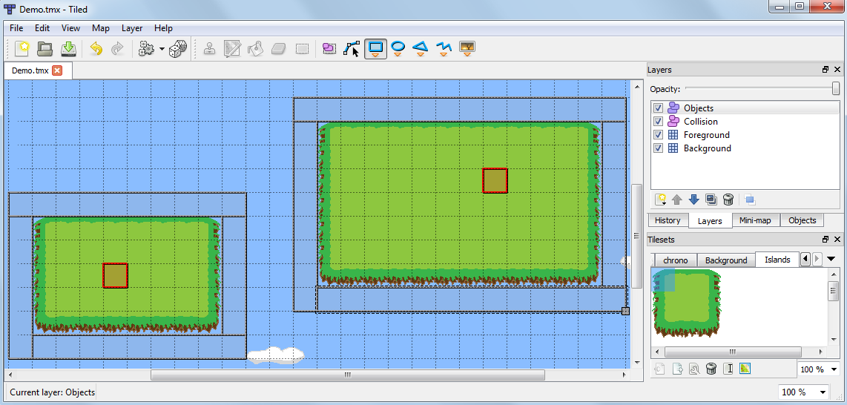
Tiled Map Editor

Slide 16
Game Demo
Now lets take a look at the engine

Slide 17
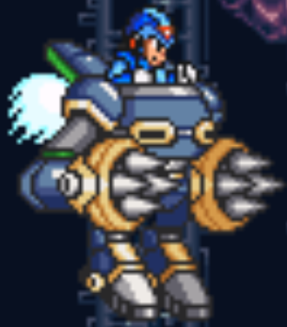
Art
Super Nintendo style pixel art
The main character is a blue spacecat who
pilots a mech suit similar to those in Mega Man X
Environment: grassy floating islands, blue sky, waterfalls
Art pipeline:
-Photoshop
-Palette: bright cheerful colors
-Tiles 32 x 32 pixels
-Sprites in various sizes
-PNG file format

Slide 18
Sound
Chiptunes or Mega Man X style synth guitars
Fami Tracker/Fruityloops
Learn how second semester
or
Attract a sound designer

Slide 19
Risk 1
Two people work 25 hours a week
Mitigation: Ask for less hours, coordinate group crunch time to improve productivity

Slide 20
Risk 2
Class work is really hard
Mitigation: Group study sessions to help one another with homework

Slide 21
Risk 3
Don’t have an Artist
Mitigation: Get one, or Alex delegates more tasks to other members so he can focus on art

Slide 22
Team Structure
Alex is the project manager and figures out:
What people are good at
What people want to work on
How busy people are with work/homework

Slide 23
Schedule
 | Alex | Nick | Jordan | Tony
Week 6 | Refactor Engine | Midterms | Midterms | Animations + Camera
Week 7 | Gamestate Manager | Enhance Object Factory | Map Collisions | Midterms
Week 8 | Art + Mechanics | AI with Actionlists | Forces + Mechanics | Parallaxing + Multi-Part Sprites

